Slide 1
penalties and constarints, intersection of constarint, determisitic optimization, boxcar on velocity

Slide 2
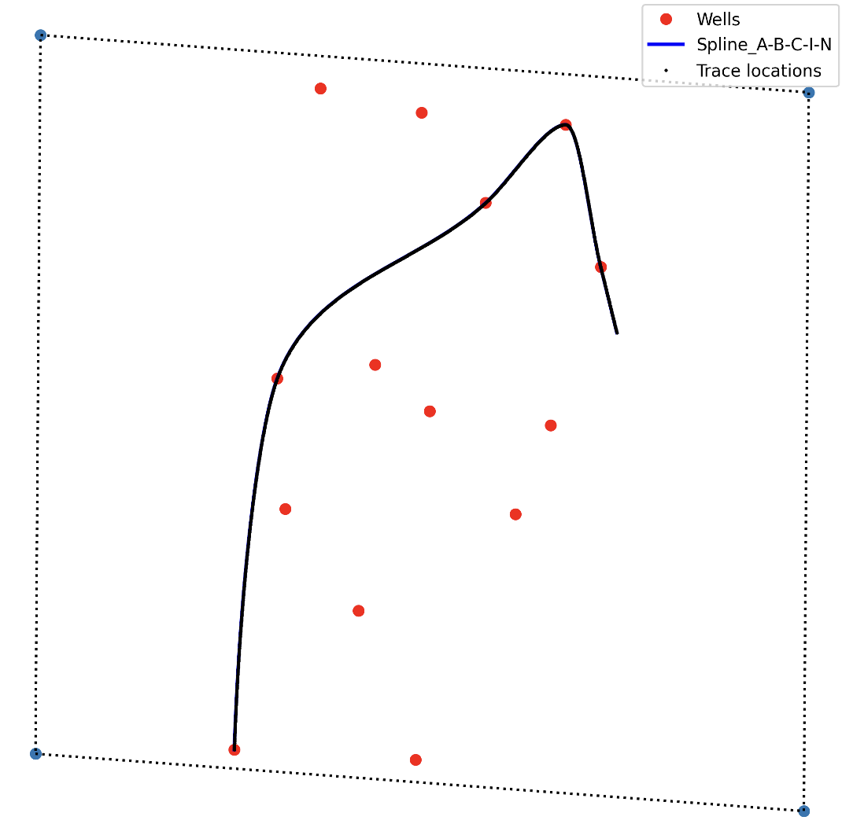
Data Collection
Regular grid points in seismic?
No
Yes
Selecting concave hull for max size with regular grid points
Velocity for time to depth using checkshots
RBF interpolation for velocity field
Plot wells inside seismic boundary
Training data (seismic +wells)
Plot quasi 2D lines through wells

Slide 3

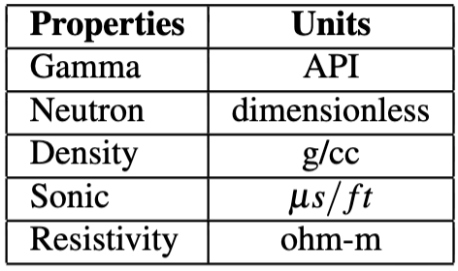
Data Collection
Regular grid in seismic?
No
Yes
Concave hull for max size with regular grid points
Visualize wells inside boundary
Smooth velocity from checkshots
Training data (seismic +wells)
Plot quasi 2D lines through wells
Time-Depth Conversion

Slide 4
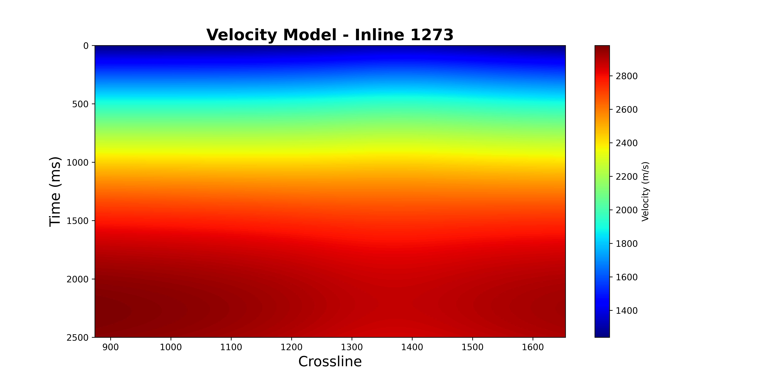
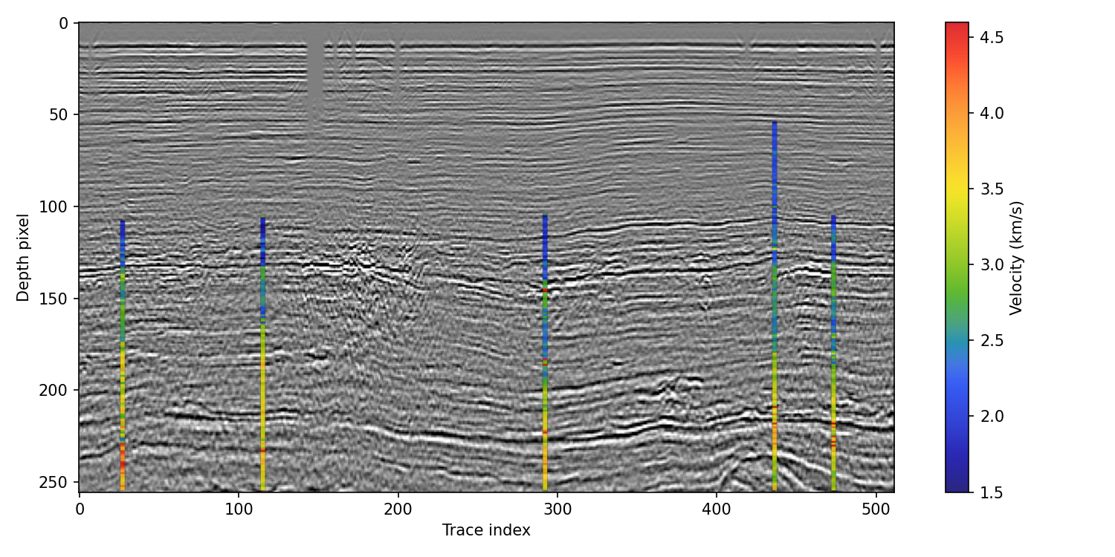
Data Collection
Regular grid in seismic?
No
Yes
Concave hull for max size with regular grid points
Visualize wells inside boundary
Smooth velocity from checkshots
Training data (seismic +wells)
Plot quasi 2D lines through wells
Time-Depth Conversion
Flow matching, optimum transport theory, learning the score, consistency models replace multi-step sampling inference phrase of diffusion models, Normalizing flow, flow matching, KL divergence, reverse KL, penalty and constraints

Slide 5
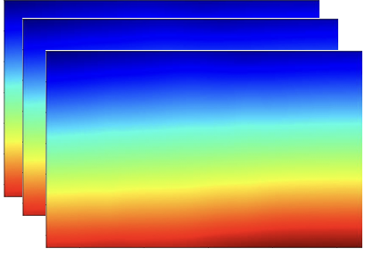
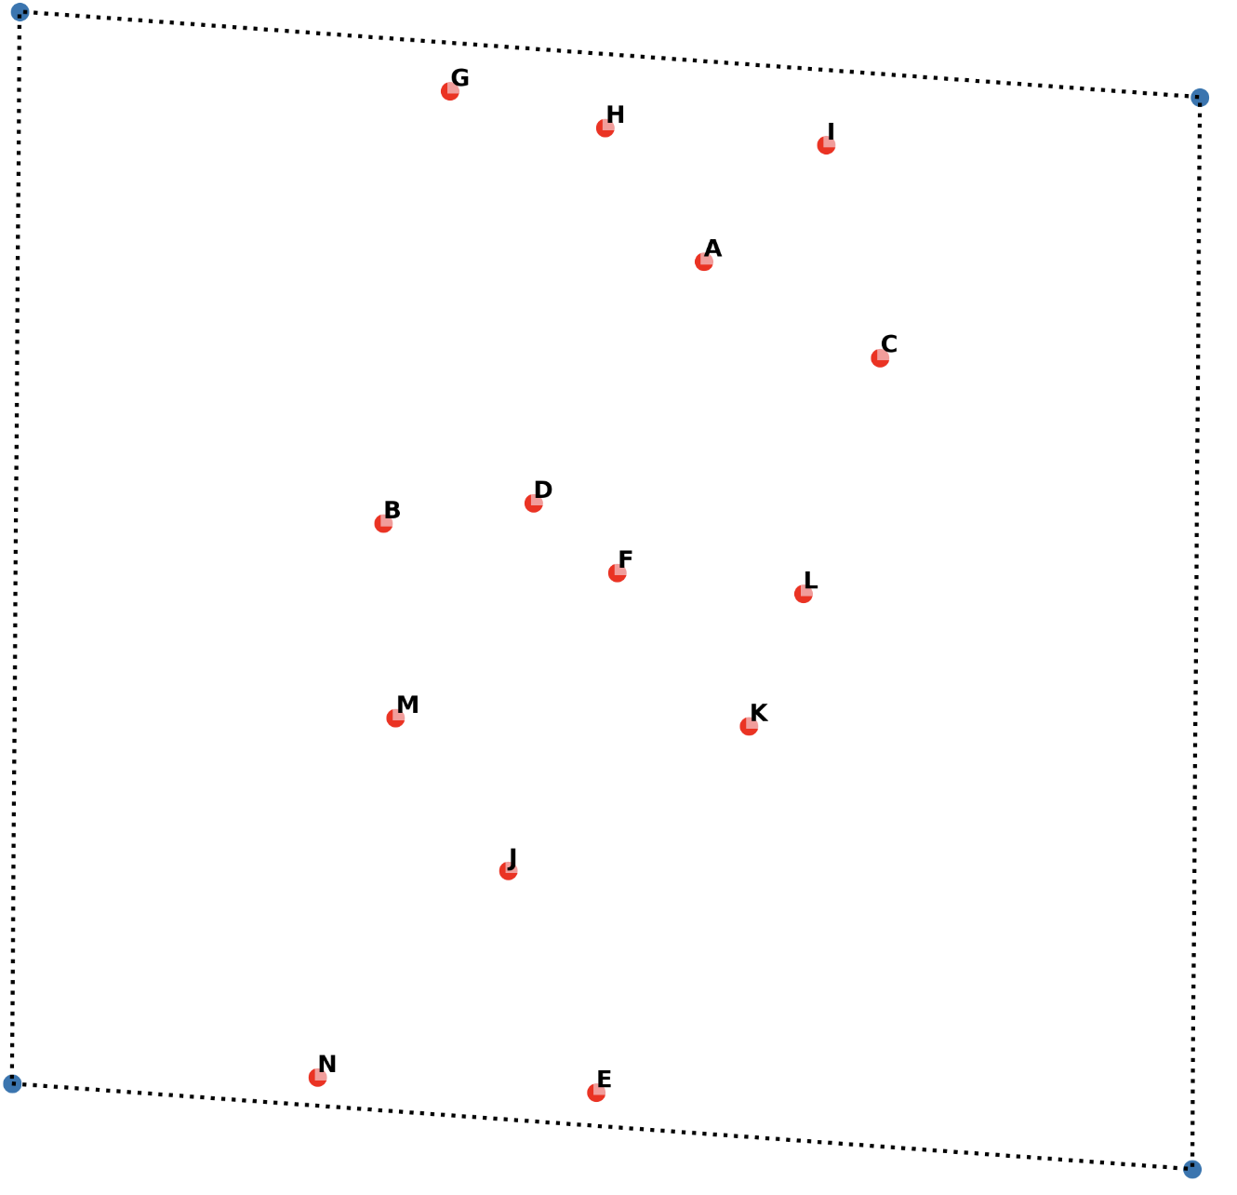
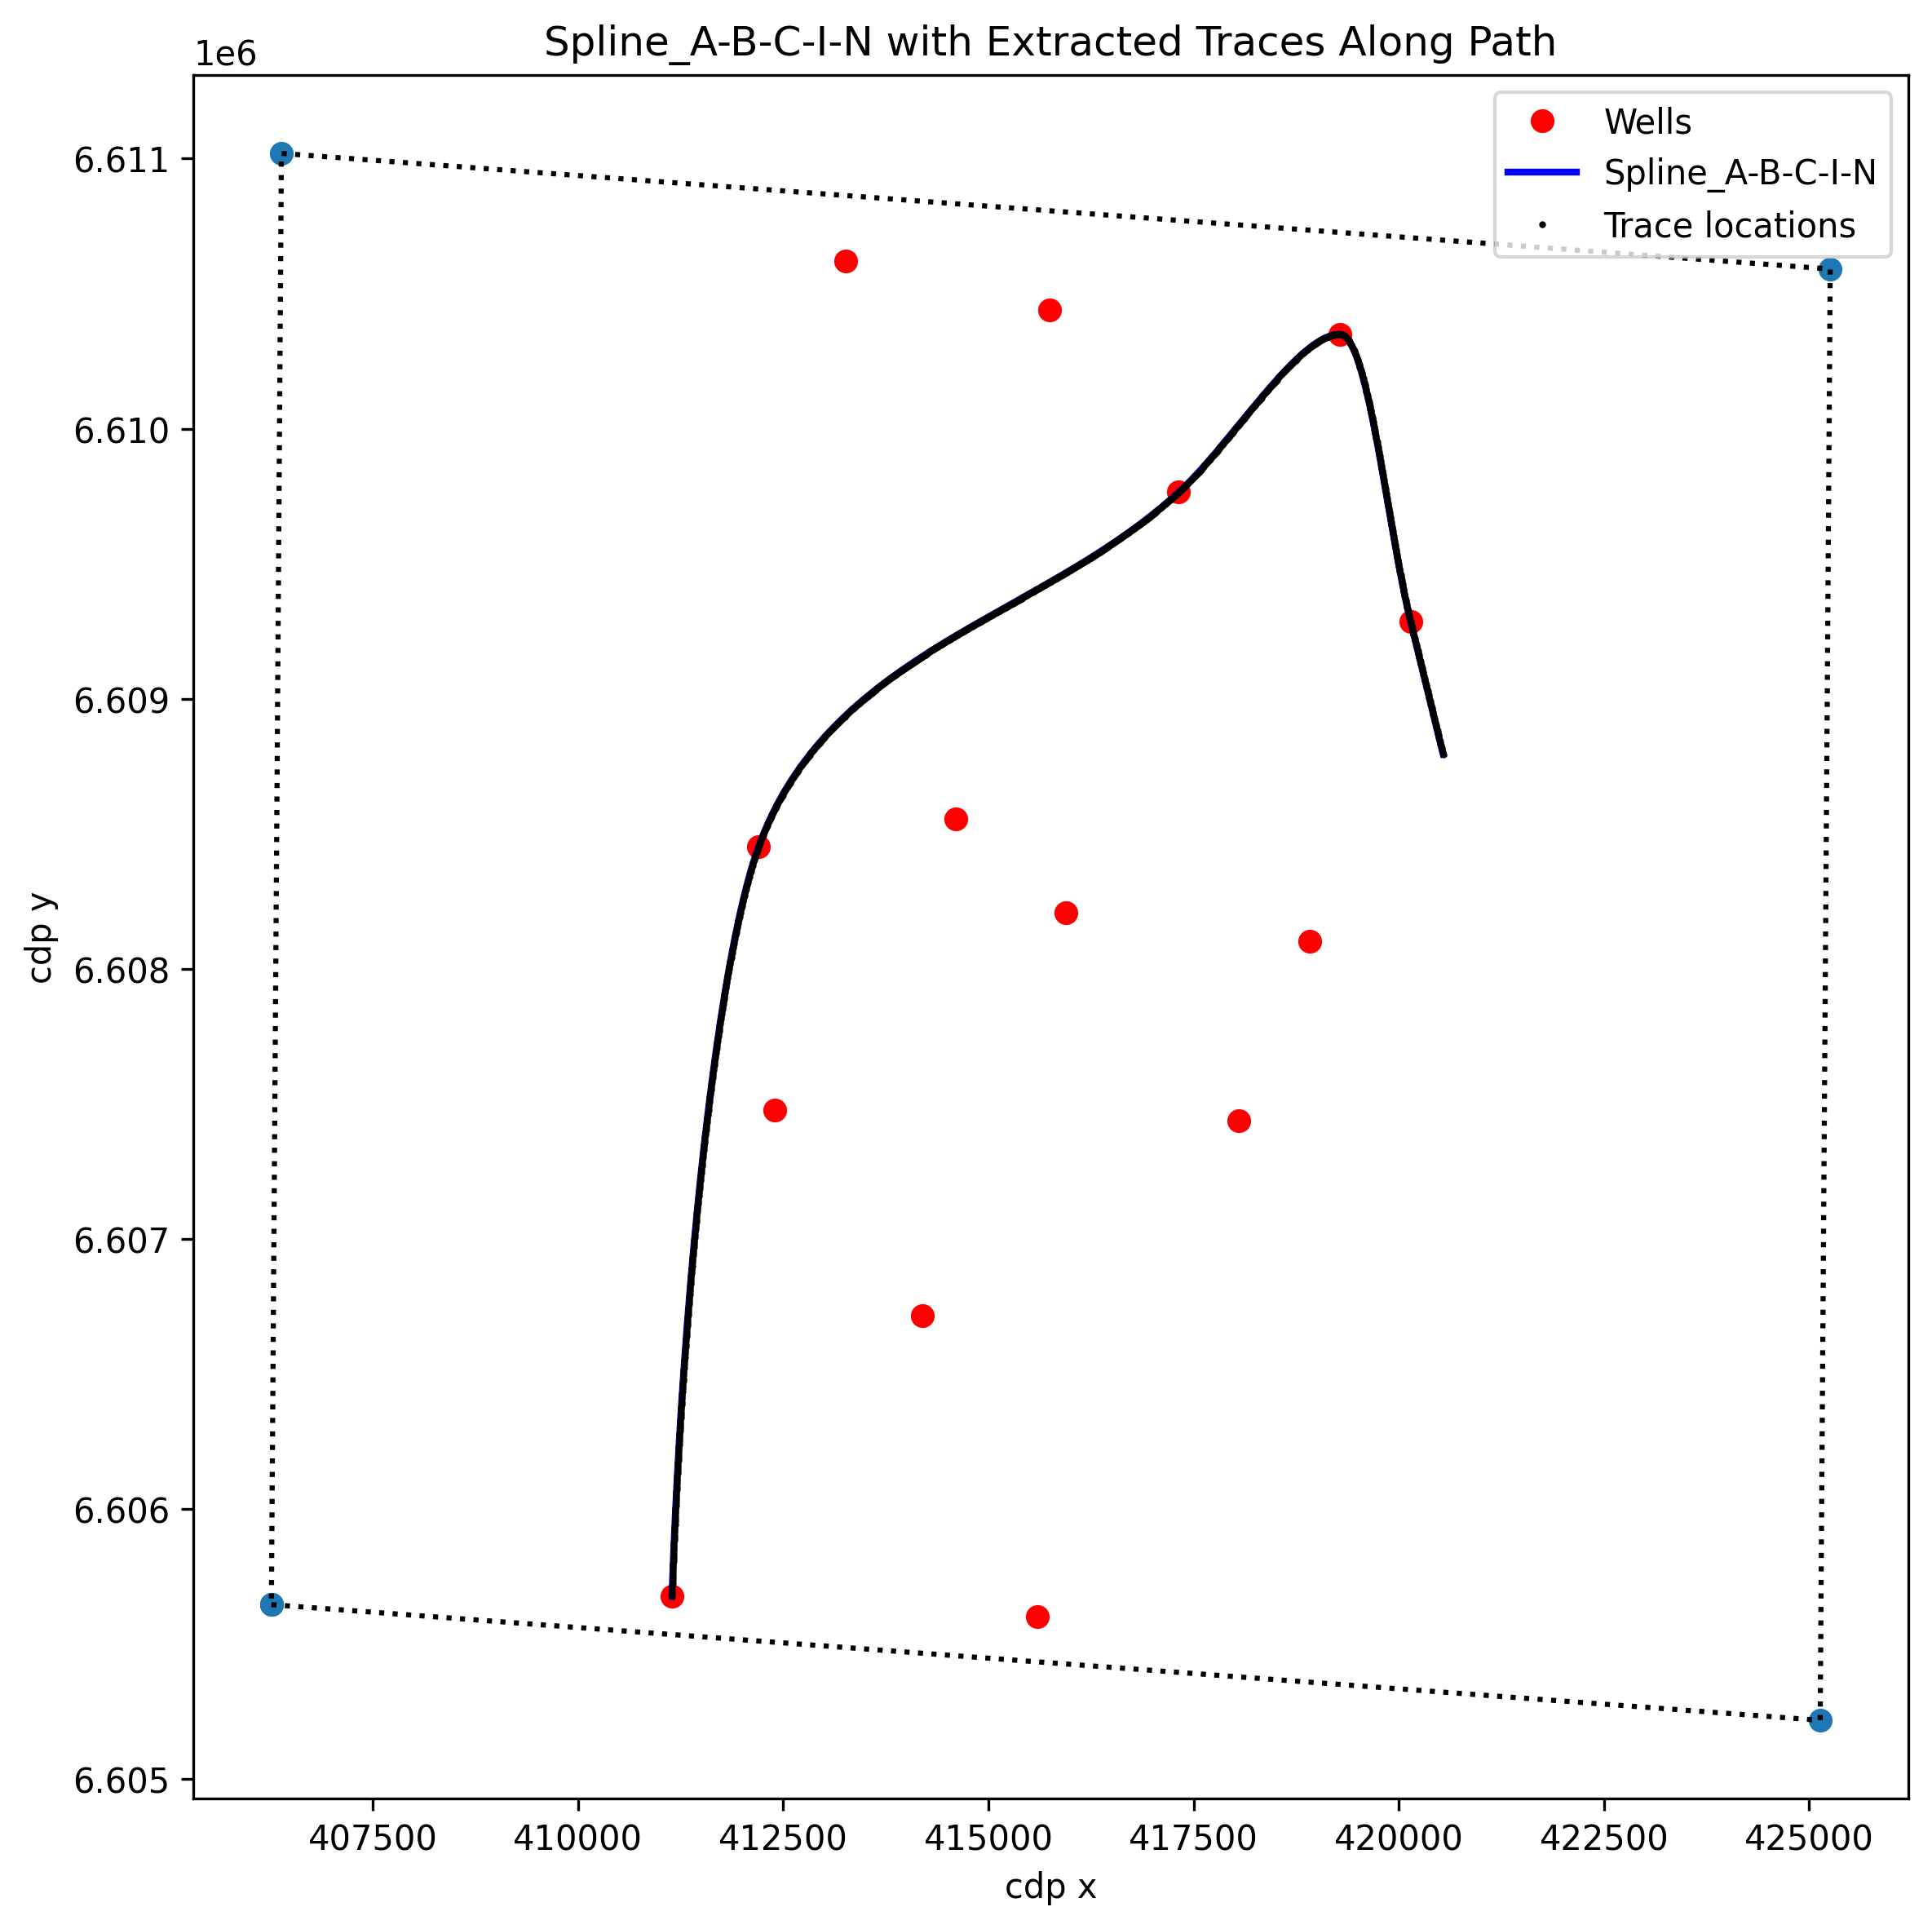
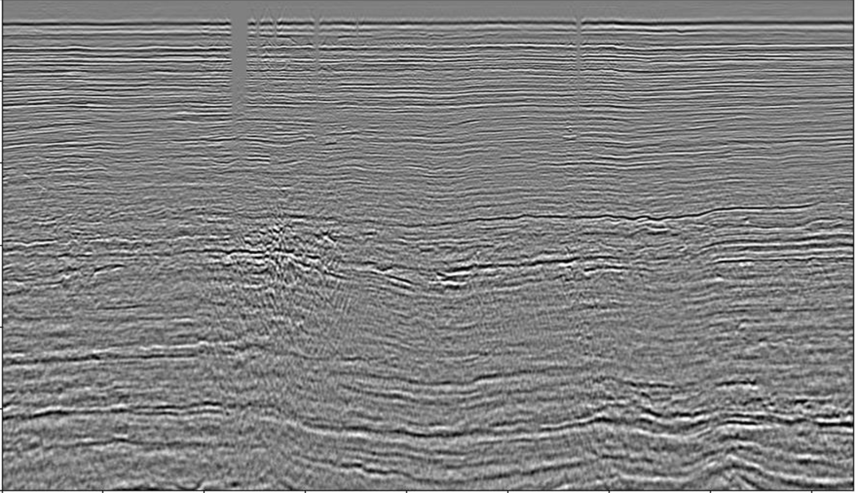
Data Collection
Regular grid in seismic?
No
Yes
Concave hull for max size with regular grid points
Visualize wells within survey
Smooth Velocity
Time-Depth Conversion
Training Data
Quasi 2D lines

Slide 7
(a)
(b)

Slide 8
Depth [m]

Slide 9
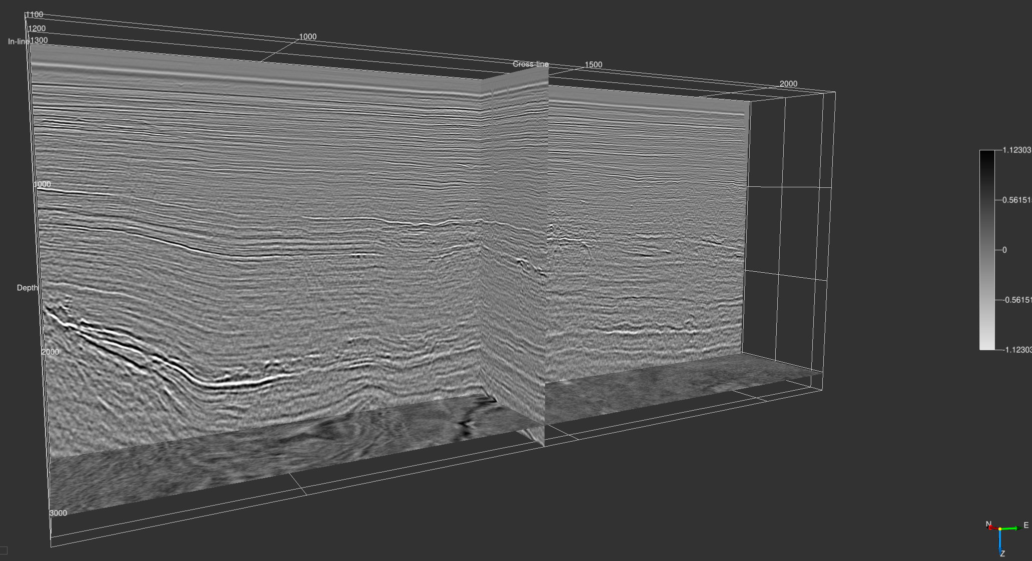

Slide 10
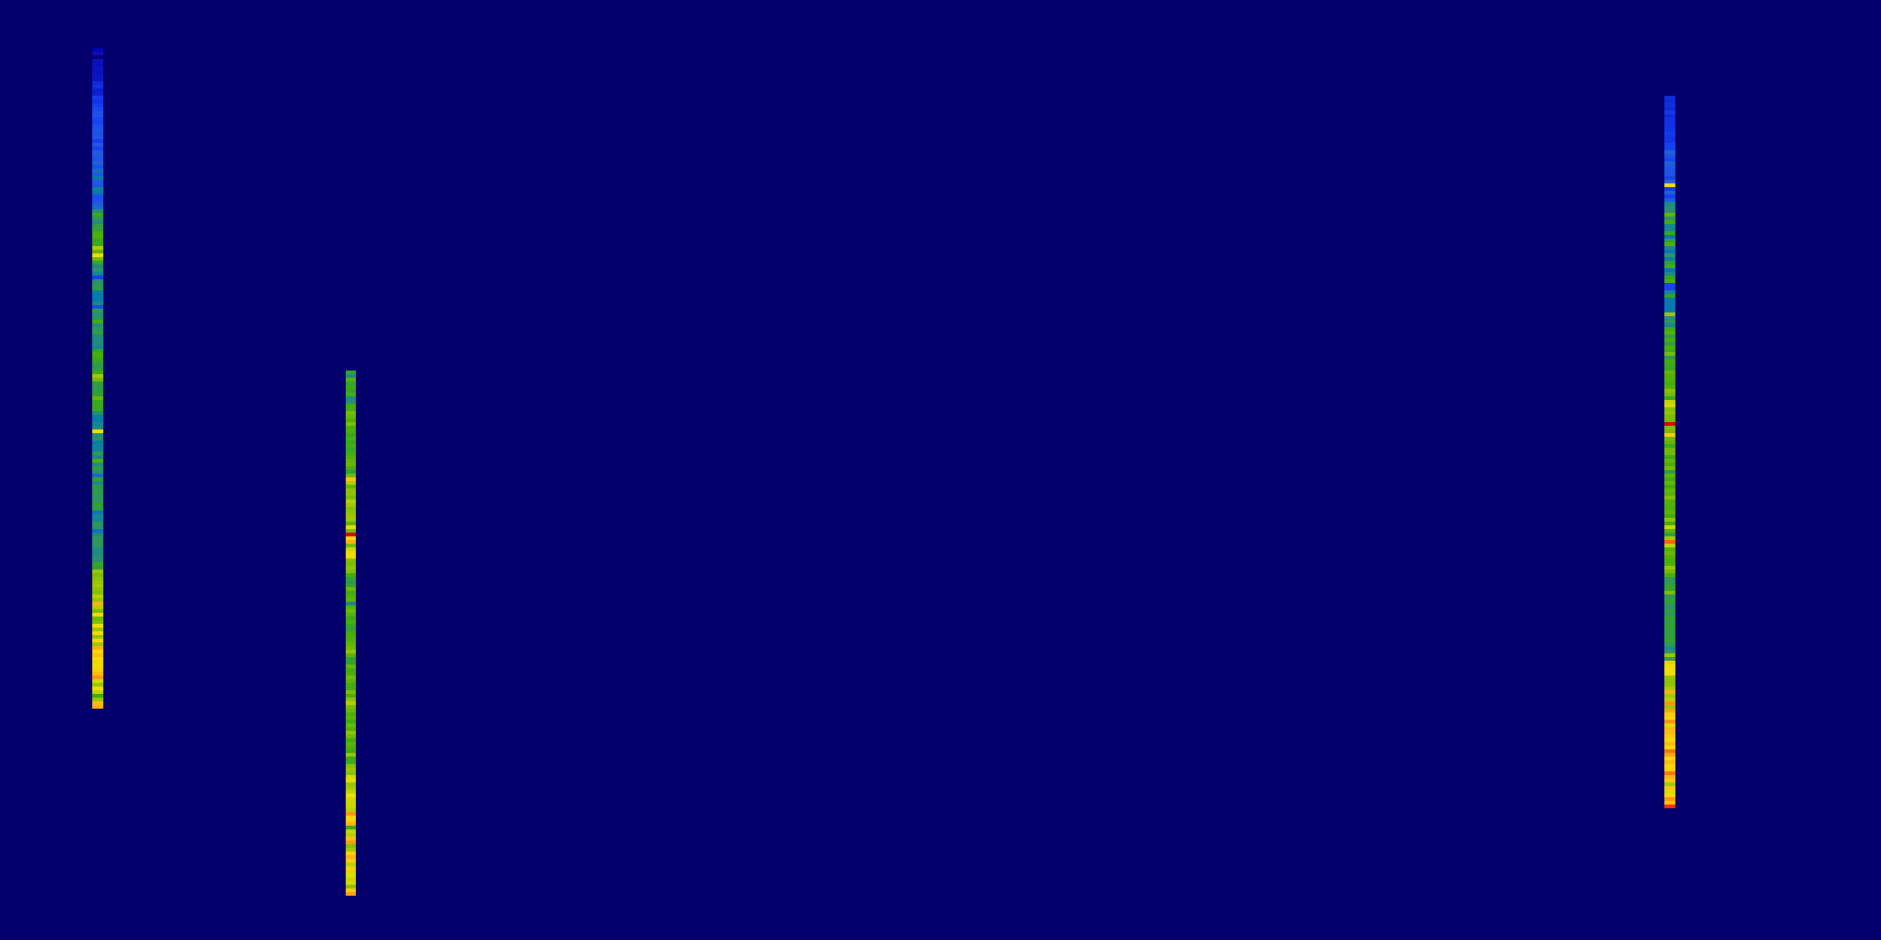
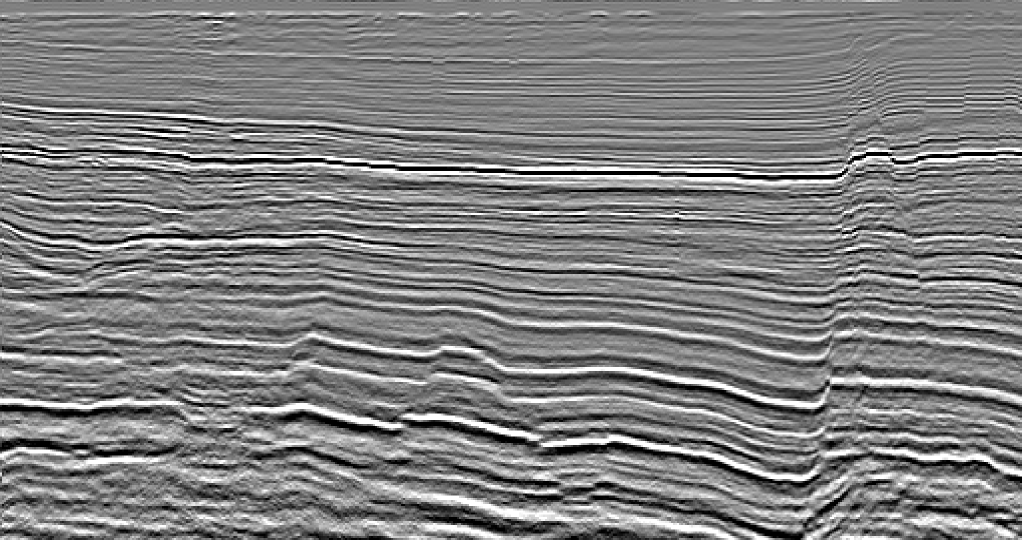
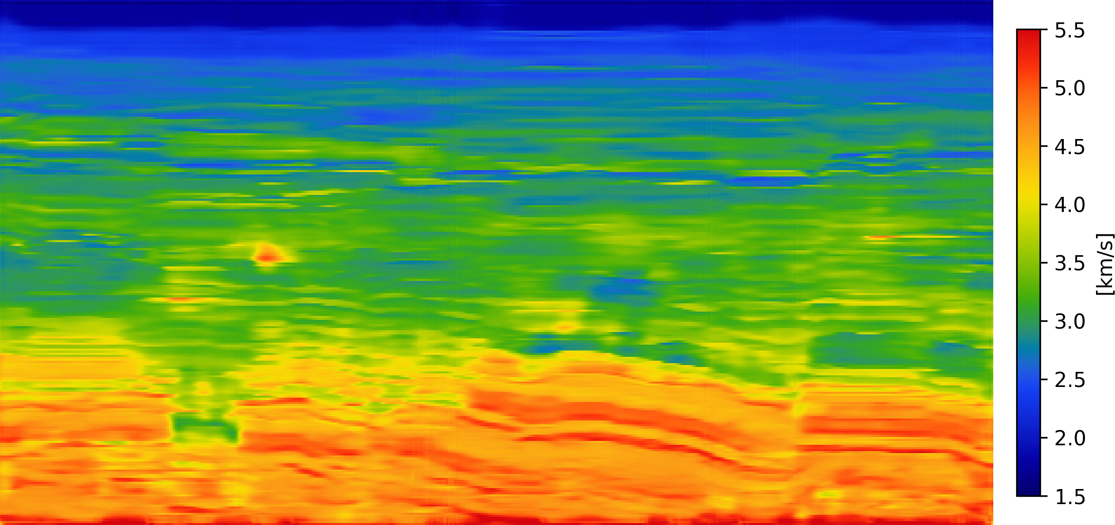
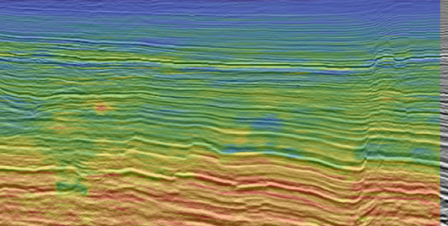
(a)
(b)
(c)
(d)

Slide 11
Depth [m]

